Slide 1
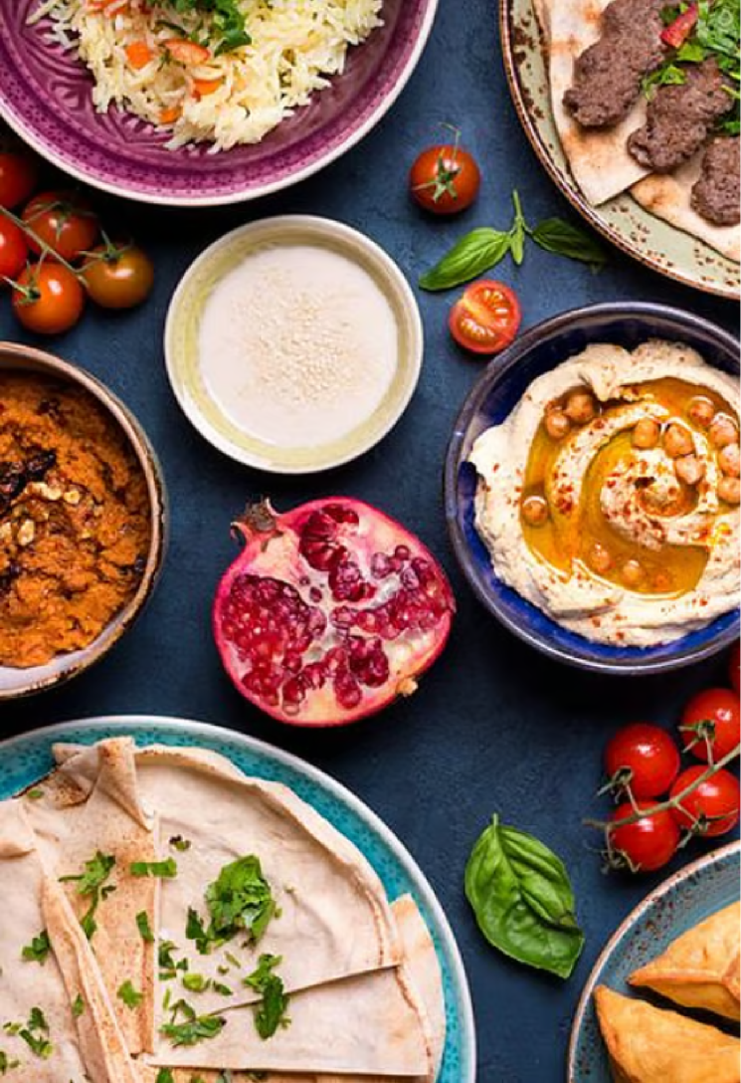
Understanding Food Practices of Middle Eastern International Students living in London:
A Mixed-Methods Study for HelloFresh
IDLE IBIS
Lisa Pinto, CID: 06054061
Payal Chand, CID: 06067958
Manjusha Chandran, CID:06052953
Jack Pritchard, CID: 06059516
Lewis Matthews, CID: 06059263
Imperial College London

Slide 2

Brief Introduction & Problem Space
HelloFresh is a German food company that has a significant presence in the UK. The main competitors are Goustou, SimplyCook, and Mindful Chef. In 2023, for the 2 million households that use meal-kit services, HelloFresh had the biggest market share in the UK of (43%) [1]
Target Audience
Middle Eastern Students living in London
Current Gaps in HelloFresh
HelloFresh currently lacks options that reflect the authentic ingredients, cooking methods, and dietary requirements of Middle Eastern students
Current menus are mostly generic with ‘Middle Eastern-inspired’ dishes, lacking the regional authenticity and diversity users expect
Tend to include broadly “Middle Eastern-inspired” meals than regionally specific options, overlooking the diversity of cuisines within the Middle East and limiting their practical appeal for Middle Eastern users.
Core Problem
Middle Eastern international students face cultural challenges cooking in the UK and current meal kit services do not meaningfully meet their needs.

Slide 3

Research Aims & Objectives
***Exploratory Sequential Design***
Understand how and why Middle Eastern international students in the UK shop, cook, and eat.
To uncover the motivations behind their food decisions, from shopping habits to the types of meals they prepare.
Translate these insights into product and service recommendations for HelloFresh, including potential new consumer segmentation strategies.
Explore their lived experiences, cultural meanings, and emotional attachments to food.
To understand how food helps them recreate a sense of belonging while adapting to life in a new country.
Identify practical, financial, and cultural challenges affecting their food practices.
To examine barriers such as cost, time limitations and unfamiliar food environments that influence their ability to cook comfortably and consistently.

Slide 4

Methodology Overview
Screener
Phase 1 - Qualitative Study
Phase 2 - Quantitative Study
Approach:
Self-selected Convenience Sampling
Approach:
Diary Study & Follow-up Interview
Approach:
Online Surveys (Microsoft Forms)
Eligibility Criteria:
To be between 18 to 35 years old.
Should be Middle Eastern university students in London
Should currently reside in the UK and have been here for not more than 3 years
Participants:
5 Participants within 18-25 age range
Native Country:
Lebanon
Turkey
Bahrain
Iran
Saudi Arabia
Held Online (WhatsApp messaging) for 5 days
Participants:
27 Responses
Wider country origin

Slide 5
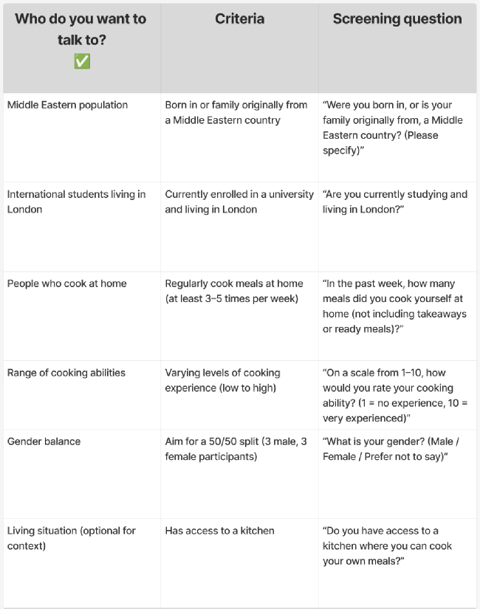
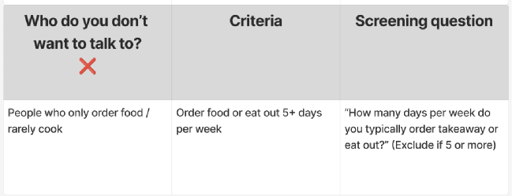
Screener

Slide 6
Qualitative Phase (Big Q)(24th Oct) – Exploratory and theory-generating
Purpose
Understand lived experiences, meanings, and challenges of food preparation for Middle Eastern students living in London
Questions
How do Middle Eastern students plan, shop for, and cook meals in the UK?
What meanings and emotions are attached to food, cooking, and cultural identity?
What barriers (e.g. halal access, budgeting, ingredient substitutions) do they face?
What forms of support or services would improve their cooking and shopping experience?
Methods
7-day food diaries (meals, photos, reflections, relative costs: low, medium, high)
Semi-structured interviews (10 minutes; guided by diary content)

Slide 7
Qualitative Sampling and Recruitment
Population: Healthy, adult Middle Eastern International students (18–35) living in London.
Sampling Strategy: Purposive maximum-variation – diversity in gender, religiosity, cooking skill, accommodation, and budget.
Recruitment: University societies/WhatsApp groups; screener with inclusion/exclusion (expect 10–20% no‑show.
Incentive: £20 voucher each per participant (n=5)
Ethics: Informed consent, confidentiality, anonymised data.

Slide 8
Quantitative Phase (Small q)(24th Oct) – Descriptive and validation-focused
Purpose
Quantify and prioritise the themes emerging from the qualitatve phase
Questions
How common are identified challenges such as halal availability and budgeting constraints?
Which HelloFresh features (price, authenticity, halal assurance, delivery convenience) are most valued?
What preference patterns or consumer segments exist among students?
Surveys - Generating categorical, ranking, and numerical data
Larger sample than interviews
Methods

Slide 9

Key Findings
Finding 4: Food waste & Cost reduction
Time Saving & Convenience
95% of respondents are motivated by quick meals.
“Taking care to preserve leftovers and using them over multiple days”
“Finds cooking or meal kit-services they’ve tried before too time consuming”
86% students showed preference for pre-prepped who want to reduce prep time
Importance of Ingredient quality & Trust
57% respondents struggle to find specific ingredients in London.
“Bought ingredients from their origin country”
“Dislikes the variations and quality of ingredients here”
Tool limitation & unique tools to aid in cooking
71% report inadequate kitchen equipment suggests shared kitchens are a major friction point.
“Lacks the storage space required for basic cooking and traditional meals”

Slide 10
Areas of Opportunity
As a direct result of research 6 product lines have been curated for students to solve the identified problems, all whilst maintaining authentic Middle Eastern Flavours.
Varied Preparation Levels:
4.
Diverse Ingredients:
Offer meals with varying levels of preparation. This shortens meal prep times dramatically.
Introduces regionally authentic spices and speciality ingredients to better reflect Middle Eastern food practices.
2.
Kitchen Accessible Recipes:
5.
Culturally Targeted Advertising:
Ensures recipes remain feasible in typical student accommodations. There will be minimal reliance on specialised equipment.
Reaching Middle Eastern students through university societies, cultural associations, and popular social media platforms.
Community Shared Recipes
6.
Student Focused Meal Line
Integrate a community recipe feature where students can share traditional dishes. This supports their emotional connections to home cooking.
Develop a specialised meal line with cooking times under 30 minutes. This is specifically for for time pressed students.

Slide 11
References
[1]
M. Gunther, “Uk meal kits: Who’s winning in london?” https://www.consumeredge.com/resources/insight-flash/uk-meal-kits-whos-winning-in-london/, 2024, pp 16-20.

Slide 12

Thank You For Listening
Notes:
why did we use convenience sampling

